Slide 1

Meadowlane’s I-Voice
2022 - 2023

Slide 2

What i-global have achieved this year
By Judy and Paige

Slide 3
languages
This year i-global and Criw Cymraeg encouraged welsh speaking throughout the school. We also encouraged speaking Spanish and Chinese. The children really loved learning new languages. Every other week we would announce the Browtheg yr wthnos (welsh word/sentence of the week)
We achieved our Siarter Iaith Bronze Award!!!

Slide 4
environment
The older years and younger years both did litter picking.
We also made posters about keeping our environment clean. We also do bin checks where we go through the bins and every other week we would announce the best bin of the week.
On top of that we made little pictures to show what goes in what bin.
We have helped everyone in Meadowlane to look after the environment!!!

Slide 5
Travelling
i-link linked us with other countries and we decided to travel to all the 3 countries Sweden, Spain and Poland. We had 4 children from year 6 go to the other countries.
After we visited them they visited us and had a tour of our school.
It is really interesting learning what life is like in other countries!!!

Slide 6
What I-Tech have achieved this year
We have filmed an i-Tech video on logging onto Purple Mash.
Led assembly on taking care of the I Pads.
Learnt about Microbits.
Information on class dojo and Twitter.
Charging the IPads.
Charging the Chrome books.
This year I Tech have made sure that children know how to use the Chrome books and I Pads.

Slide 7
What I-Com have achieved this year
I.Com is where we go around and ask kids what they have been learning and put it on dojo.
We learn about what has been happening in classes.
We are thinking about having an assembly about what we have done and asking everyone what they have done.
We have made sure that parents know all the amazing things that go on in our school!!!

Slide 8
What I.Link have achieved this year
I.Link created posters for the school fair to put around the school and to share with the community.
We have also got e-mailed people to get vouchers for prizes. We had 2 responses.

Slide 9
What I Health have achieved this year
Checking peoples lunchboxes
Take pictures of lunchboxes if it is healthy
We did a healthy teeth video and posted it on YouTube
We told everyone to make healthy Lunchboxes
We encouraged everyone to make healthy lunchboxes
We went to classes and reminded then to do the wake and shake
We did a fitness fun day
We organized the playground Equipment
We organized that the youngers can go into the older peoples playground
We have helped everyone at Meadowlane to be healthy!!!

Slide 10
What i-rights have achieved this year
We made videos about the rights. These have been shared on Class Dojo.
We did a class assembly about the class rights.
This year I-Rights have made sure everyone knows the rights. We are now ready for our Gold assessment.

Slide 11
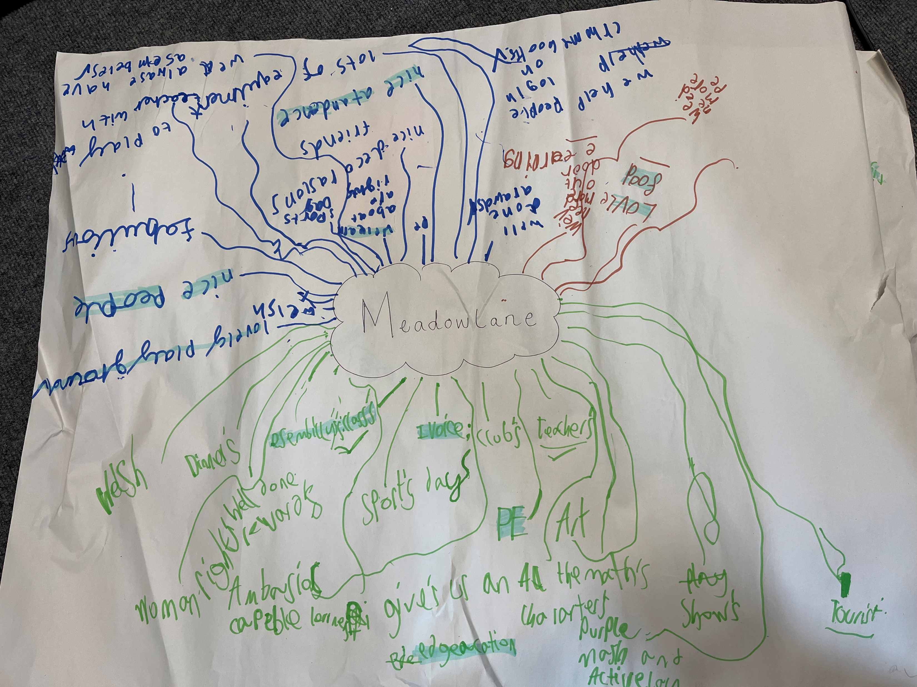
We carried out a review of the year
What is great about Meadowlane?

Slide 12
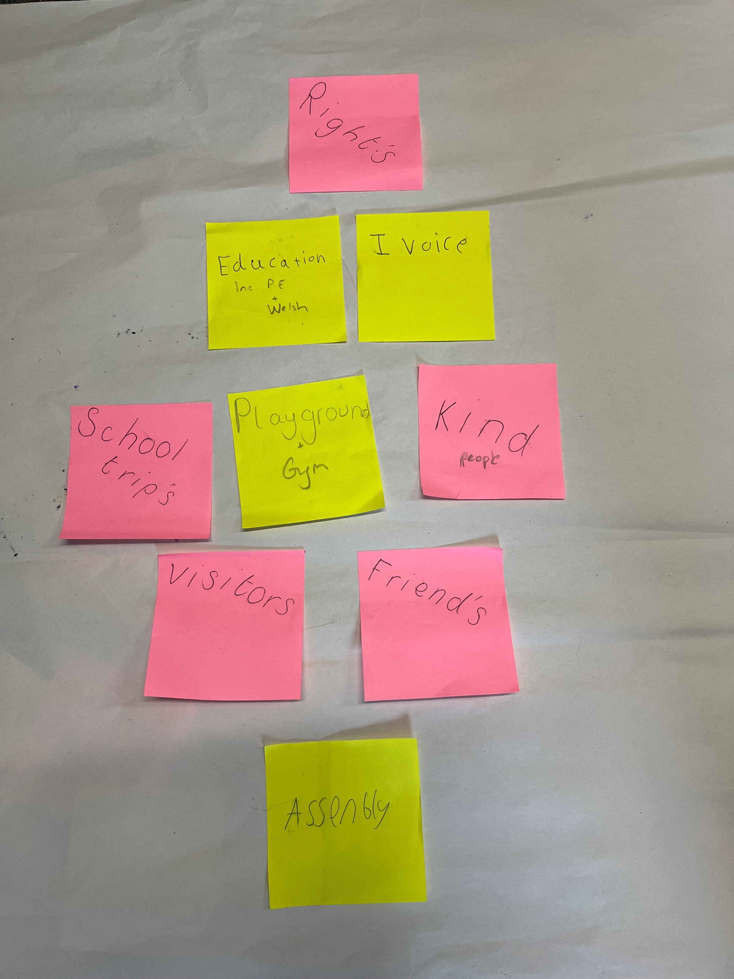
We created a diamond nine of the top nine things about meadowlane

Slide 13
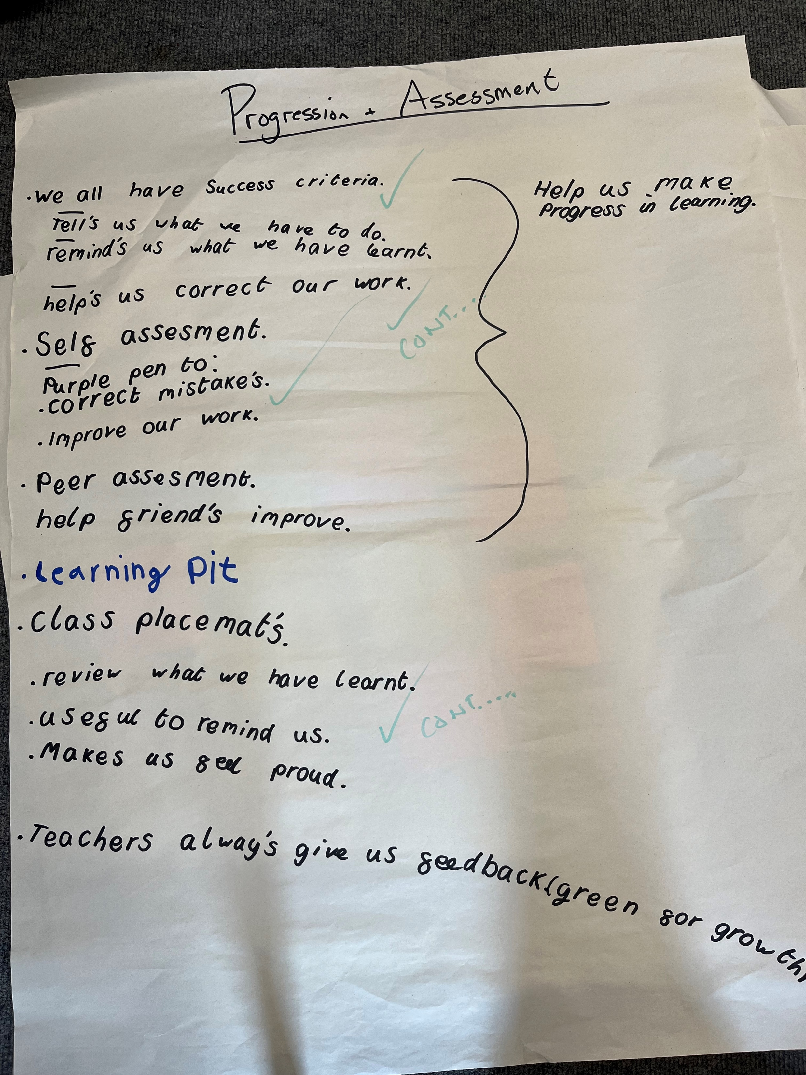
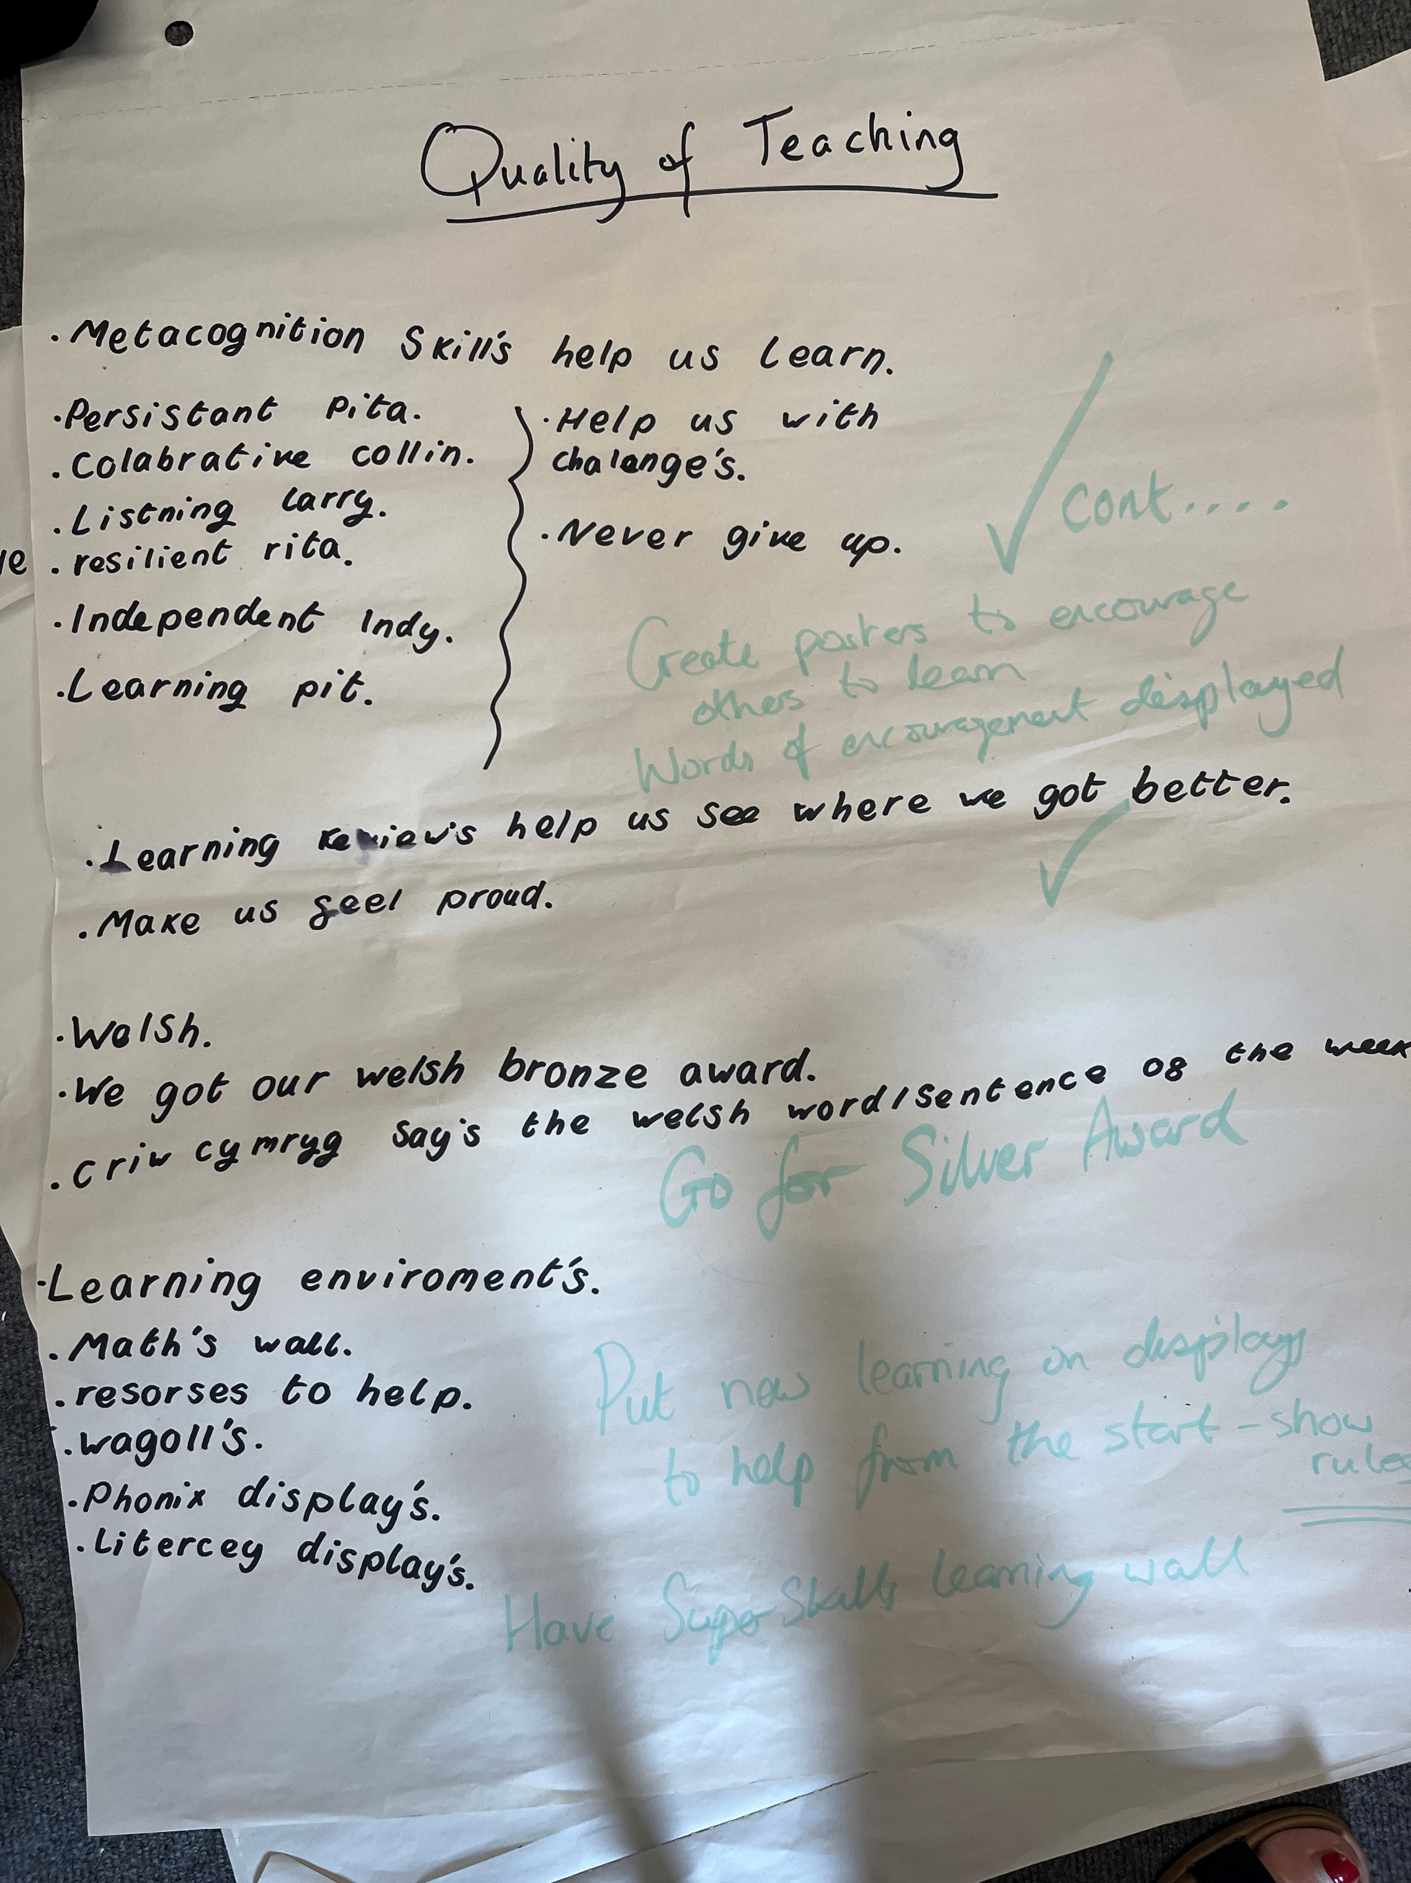
We reviewed the school’s work

Slide 14
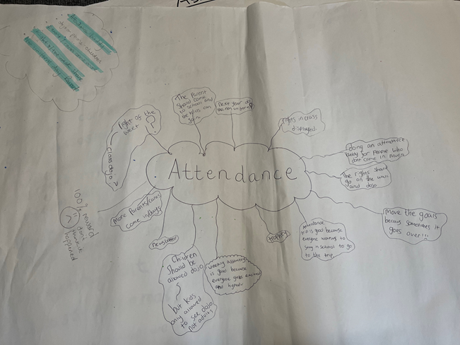
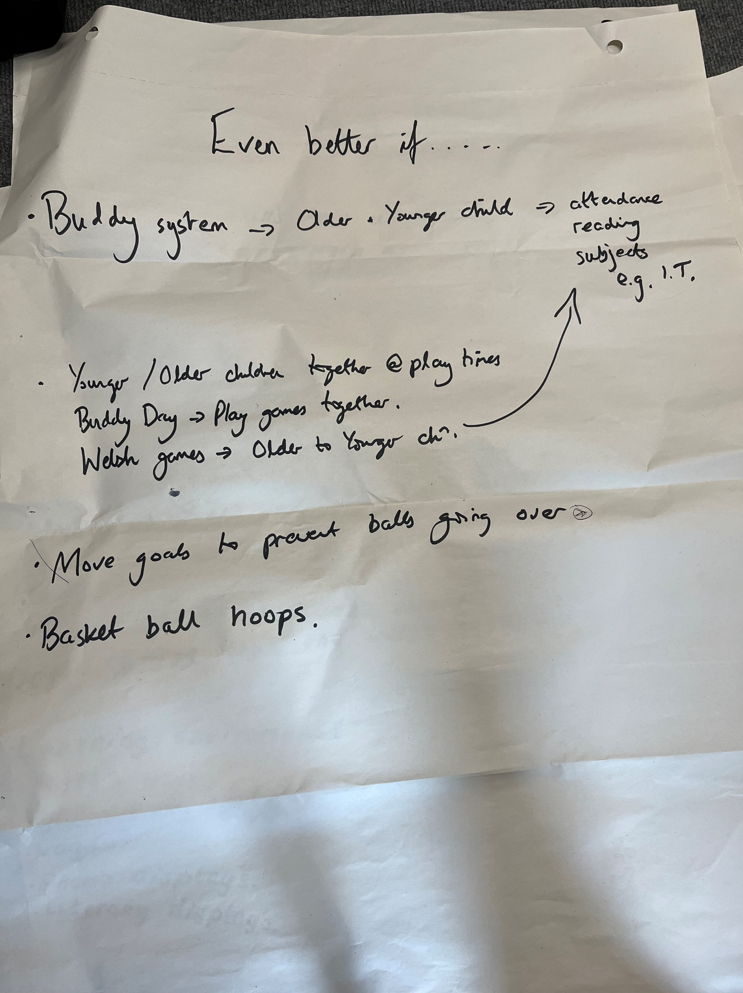
And we suggested ideas for next year…

Slide 15
New groups for September:
Years 1 and 2 will be our ‘Eco-Warriors’
Dosbarth Clun will be our ‘Green Team’
Dosbarth Rhymney will be our ‘Nurture Champions’
Dosbarth Usk will be our ‘Healthy School Team’
Dosbarth Severn will be our ‘Children’s Rights Champions’
Dosbarth Dee will be our ‘Criw Cymraeg’
Dosbarth Ogmore will be our ‘Tech Support’

Slide 16
I-Voice 2023 - 2024
One representative from each class
Will you apply to be on our I-Voice next year?

