Slide 1

Well done Meadowlane!
The results are in.....
75.6% of the children from Yr1-6 actively travelled to school between 24th march - 4th Aril 2025.

Slide 2
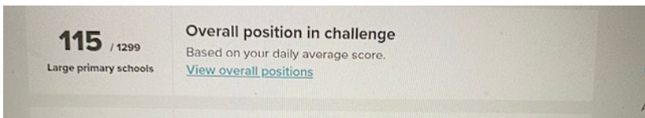
Meadowlane Primary came 115th out of 1299 schools taking part across the country.

Slide 3
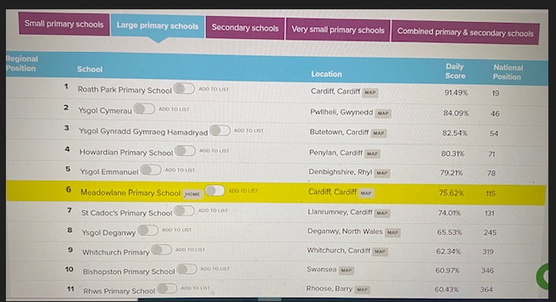
Meadowlane Primary came 6th place in Wales....

Slide 4
The results are in for each class.....
In third place with 199 active travel points...

Slide 5
Dosbarth Usk

Slide 6
In second place with 202 active travel points...

Slide 7
Dosbarth Dovey

Slide 8
And in first place with 207 active travel points...

Slide 9
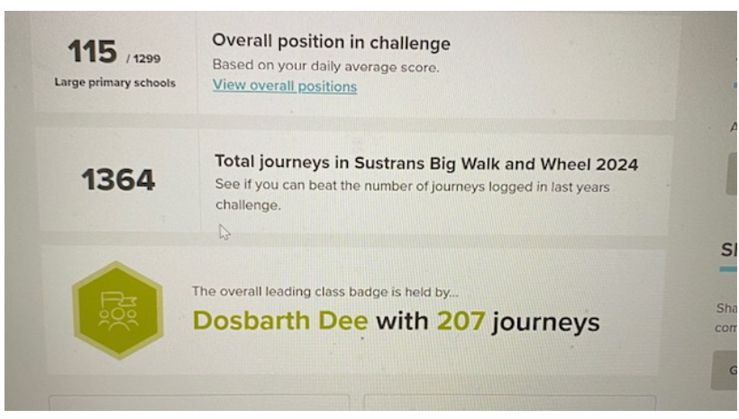
Dosbarth Dee

Slide 10
CONGRATULATIONS
LLONGYFARCHIADAU!!

