Slide 1

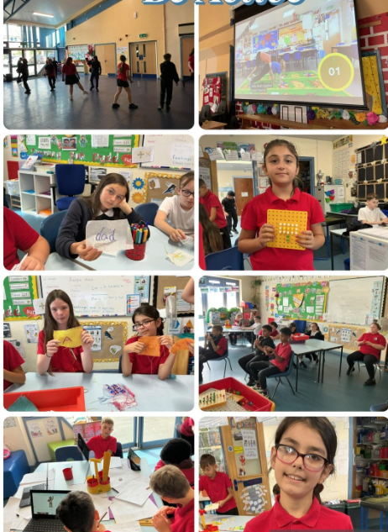


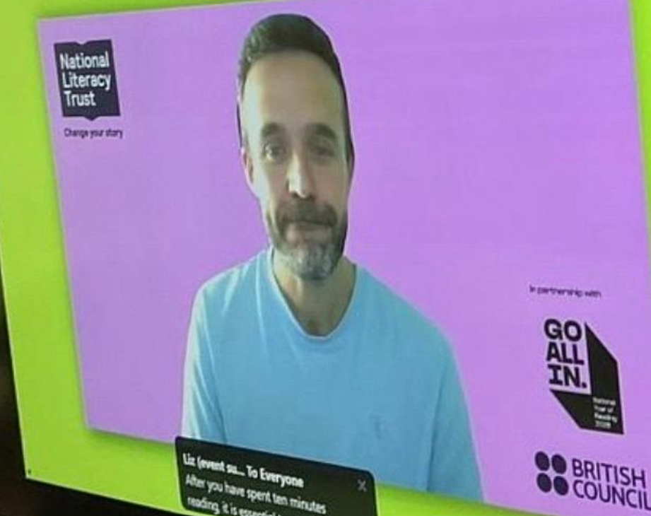
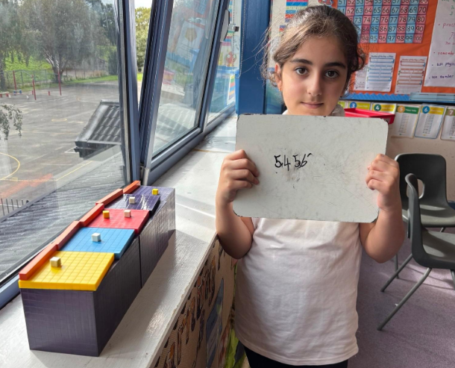






"We have taken part in Well-being weeks. At the start of this term"
Year 5 & 6 ‘Pioneers’ Placemat’
Autumn Term 1- Conflict and Resolution
What have we been learning…
“When we come into class we do a morning starter activities.'
"We have a well- being circle every Monday and had a reflective circle on a Friday. We have an Assembly each day.
We have a Dojo check in every morning using Sut wyt ti?"
“We have completed activities on the 5 Steps to Well-being.”
“We learn our High Frequency words in Spelling time and test ourselves.”
“In LLC we take part in Reading Attack and Monster Phonics activities.”
We all took part in the National Reading Challenge and became Guiness book of record holders, And had visits from two authors and a poet."​
“We have been learning to add/subtract using manipulatives, representations and inverse operations.”
“We complete Reading activities every day ”
“We have been taking part in Oracy activities each week using new sentence stems".
“IN M&N we have completed activities on Place Value. We know the value of digits and what they represent.
“We have written a Non Chronological Report about the 5 Steps to Well-Being.”
"
“We have been deriving complements and have been adding and subtracting using the column method.​"
Applications of Learning AoLs
Literacy: Non-Chronological Report: How World War 11 Changed the World.
Numeracy: World War 11: Number through Time
Digital skills: creating and using algorithims to code and debug. Accessing google classroom.
We have been self and peer assessing our LLC and M&N work as a means of tracking progress and moving our learning forward.
"We have been checking our answers using inverse operation methods and checking to see if our answers anre reasonable."
‘We take part in weekly problem-solving activities to secure our knowledge and understanding of maths skills covered."
"We take part in Big maths every day and complete the BM test every week."

Slide 2


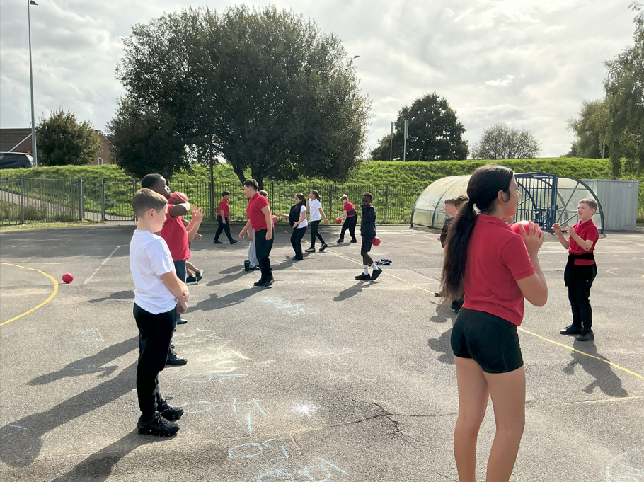


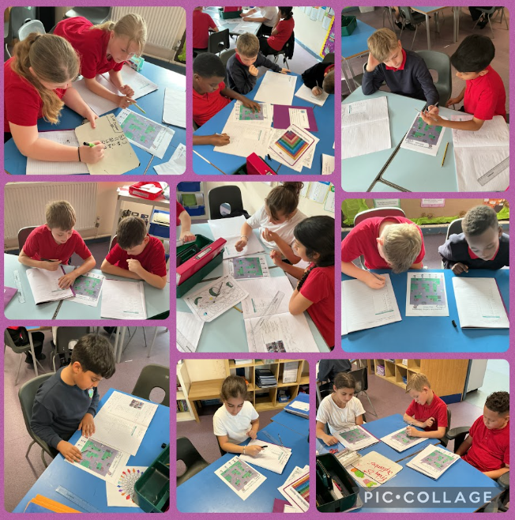
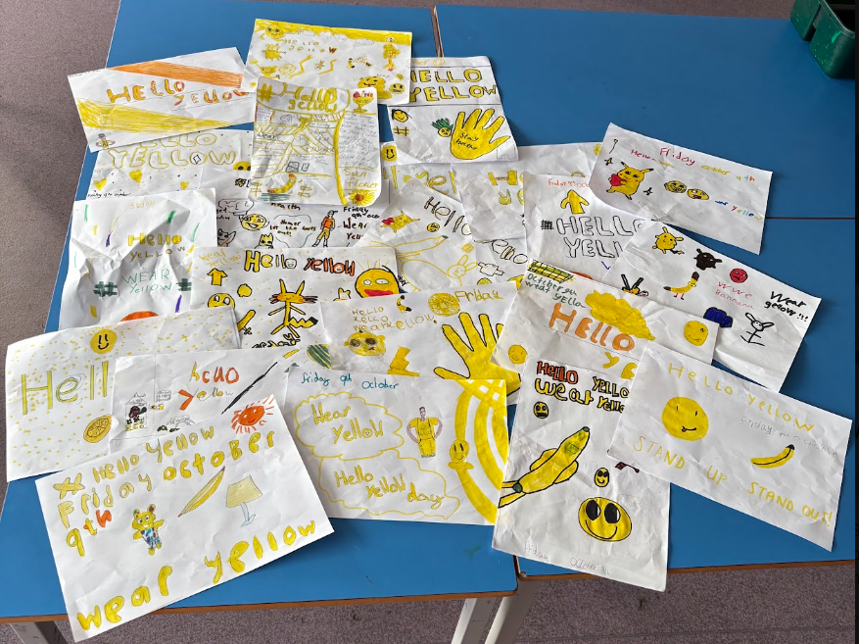

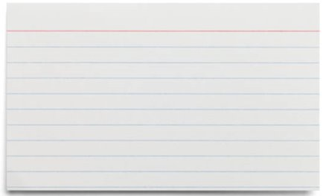
“We have been accessing Google Classroom to complete different types of activities..”
“Dosbarth Rhymney are Criw Cymraeg. We have been teaching the younger children songs and the Brawddeg yr wythnos..."
“Dosbarth Usk are the Well- being Team. We promote being and staying healthy. This half term we have promoted World mental health Day ~Helloyellow".
“Dosbarth Clun are the Belonging team ."
''We have been learning the parts of the body yn Gymraeg.''
" We have have been using Purple Mash to Code, Collect Data and create a survey in ICT."
''Dosbarth Usk led a whole school Assembly all about harvest''
"We have been creating and following Algorithms and finding errors and debugging them in ICT."
"In PE we have been developing,applying and exploring our ball skills by playing many exciting games."
“We have studied WWII in Superskills looking at an Evacuee's Suitcase Maping the outbreak of WWII and looking at the Timeline of events during WWII.”
“We have learned to recognise reliable, misleading or fake content online.”
"We have learnt how to answer Faint ydy dy oed di in welsh with Dw in....oed and say which month our birthday is in.
“We have been shaping our online identity in ICT.”
“We have developed our Welsh oral skills and been learning how to say and answer Sut wyt ti'n teimlo? using Dw I'n....,Dw I ddim yn.....Wyt ti'n iawn?
“We have Cymraeg Bob Dydd Daily and have been learning to say – Beth yw dy enw di? Ga i....Sut wyt ti?”
Metacognition focus
Perseverance and Resilience: We must keep our emotions in check to push on through our tasks…
Independence: We use working walls, WAGOLLS to support our learning along with our Toolkits and Technology to help us work independently.
I
“We celebrated Shwmae Su'mae day , we carried out activities, held a competition and an assembly and all joined in singing 'Yma O hyd'.
“In PE we have been very lucky to be taught SoftBall by Holly.”

