Slide 1




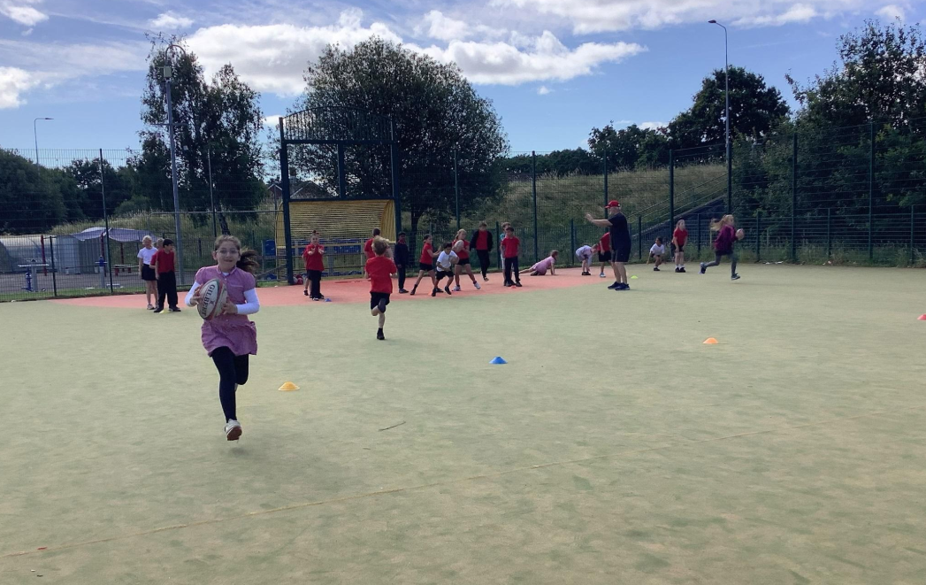
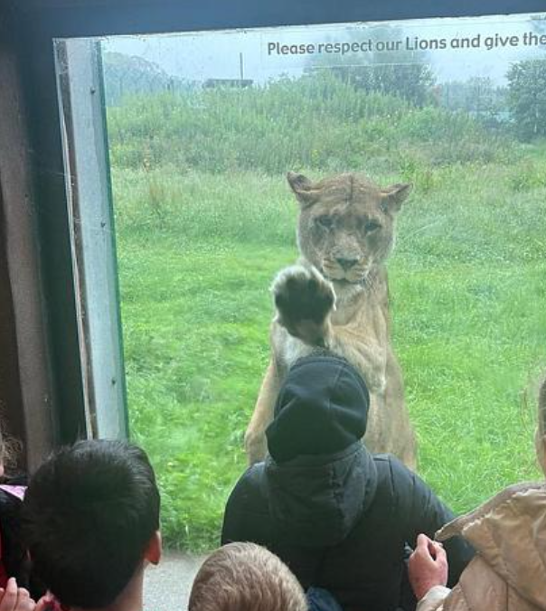
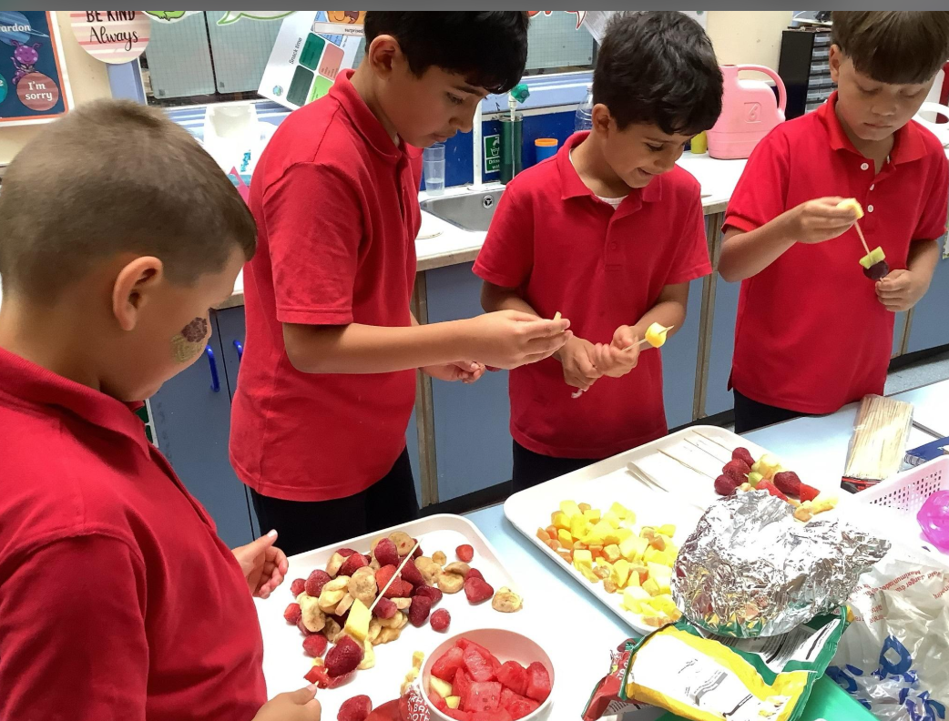

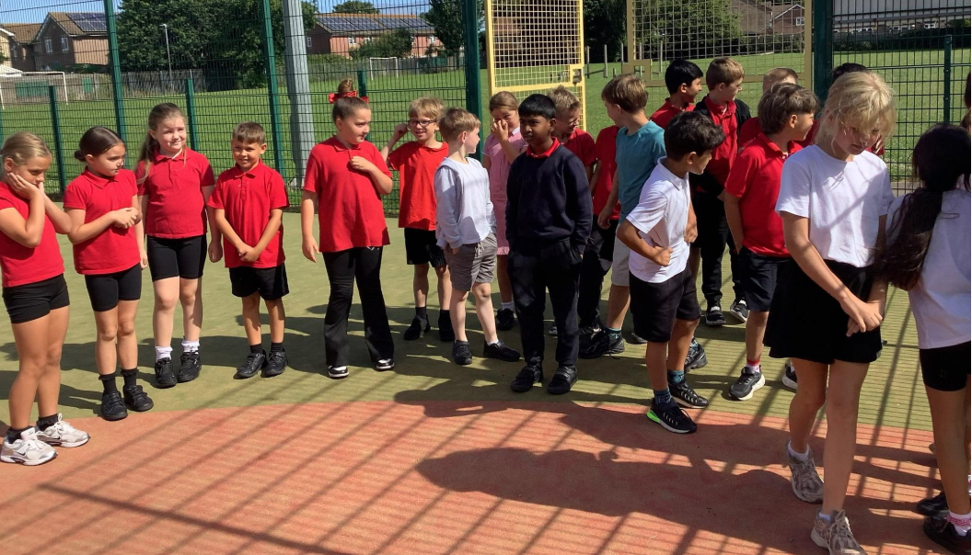
I liked making £5 grow because we got dominoes pizza by Safra.
I enjoyed going on the school trip to Foly farm. enjoyed seeing the lions. By Kymani.
I enjoyed adding using column addiition by Lexie
Like playing with my brother on the playground by George,
i liked the dominoes party. The pizza was yummy.
I enjpyed the enterprise and selling the things I Made by Ameer.
I enjoyed sports day. I liked the long distance by Saleh.
Summer Term 2
Dosbarth Rhymney
All things bright and beautiful.!
I
II enjoyed my I – Voice day we played lots of games and had a nice lunch. By Haajar,
.
The Four Purposes ​
LLC
Features of a story AOL review
Verbs/ past tense
Scene description.
2A sentences revisit
Similies
BOYS sentences Revisit
Reading – GGR / reading attack.
Cymraeg bob Dydd
Fy ffrind ydy__________
Mae e'n/ Mae hi'n ….......
Maths
Fractions
Telling the time/ reading a timetable
Make £5.00 grow
Addition / subtraction with money using column addition.
Data Handling Venn diagram/ Bar chart/
DCF – create a bar graph
Using A I
Pic collagage
Using Google classroom/ . CANVA / Powerpoint
I
I liked playing with my friends and having a good laugh at playtimes.. By Finley.
I liked being part of I -voice and talking about Criw cymraeg. By Haajar
.
I liked it when we had to do the 3 second dance in rugby. I did the michael Jackson by Carson
I
I enjoyed taking part in the obstacle race on sports day. By Adza

Slide 2
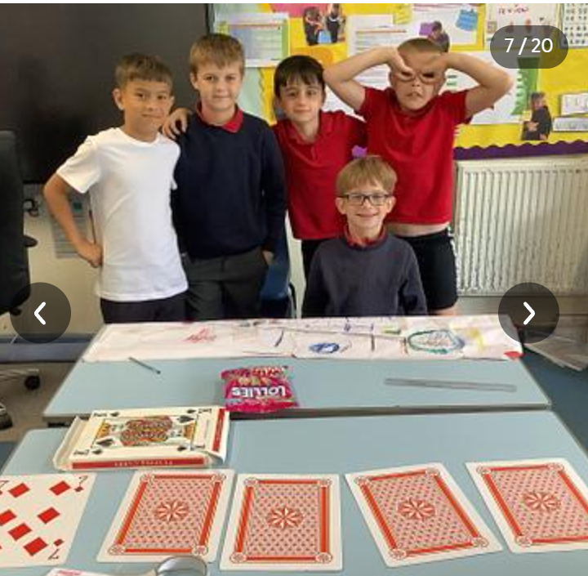
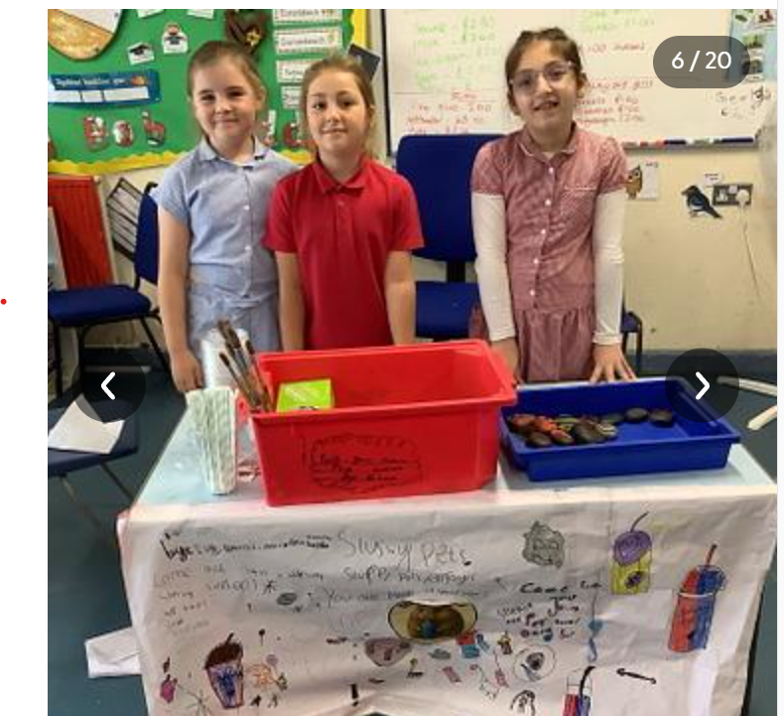
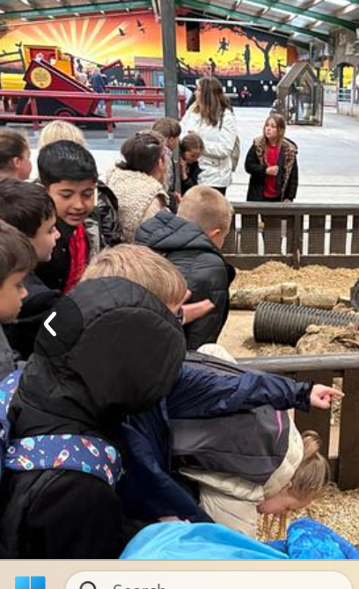
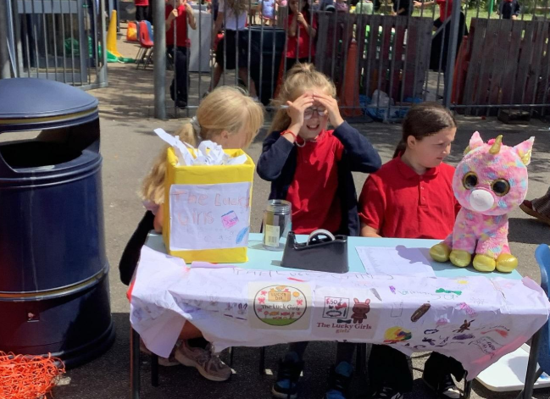
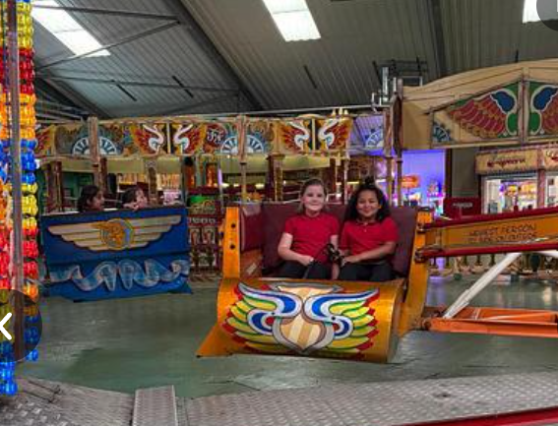
I enjoyed winning the golden ticket and going to Hickorys and watching the movies. By Mohith,
II liked playing hide and seek and rubby with Carson and Elias
Sports day was fun. I ran every race and won them all
by EIias.
I really enjoyed the caterpillar ride at folly farm. It was great fun By Karar.
I enjoyed making the slime for enterprise but it was hard to make the mixture by seren.
Summer Term 2
Dosbarth Rhymney
All things Bright and Beautiful
I
I enjoy reading every day By Marcus.
I
The Four Purposes ​
Ambitious, capable learners –
To enjoy challenge
Use Welsh in conversations,
Use digital technologies A.I,
Ethical, informed citizens
Finding out about our culture. Aberfan, sennedd, cofiwch
dryweryn.
Celebrate being Welsh.
Healthy, confident individuals.
Manners
Confidence
Working on stickability. Stick at things for longer.
Enterprising, creative contributors -
Make £5 grow, make and sell a product.
Collaborative learning help others look at the problem.
Metacognition
The Learning Pit ,
Collaborative colin
I enjoyed singing the songs in the show and the year 6 assembly By Fraya.
I enjoyed singing the songs in the show and the year 6 assembly By Fraya.
I enjoyed the soft play and the rides at folly farm By Amelia.
I enjoyed working out column addition. I persevered by Liam
I enjoyed our trip. It was exciting when the lions pounced on the window at folly farm. By Ivy.
The waltzers were so fast by Romannie.
I enjoyed writing about the review about folly farm in literacy. By Noel.

